Slide 1
NEO4J CYPHER TUTORIAL WITH PYTHON
Create Neo4j Graph From Csv File
Tutorial 77

Slide 2
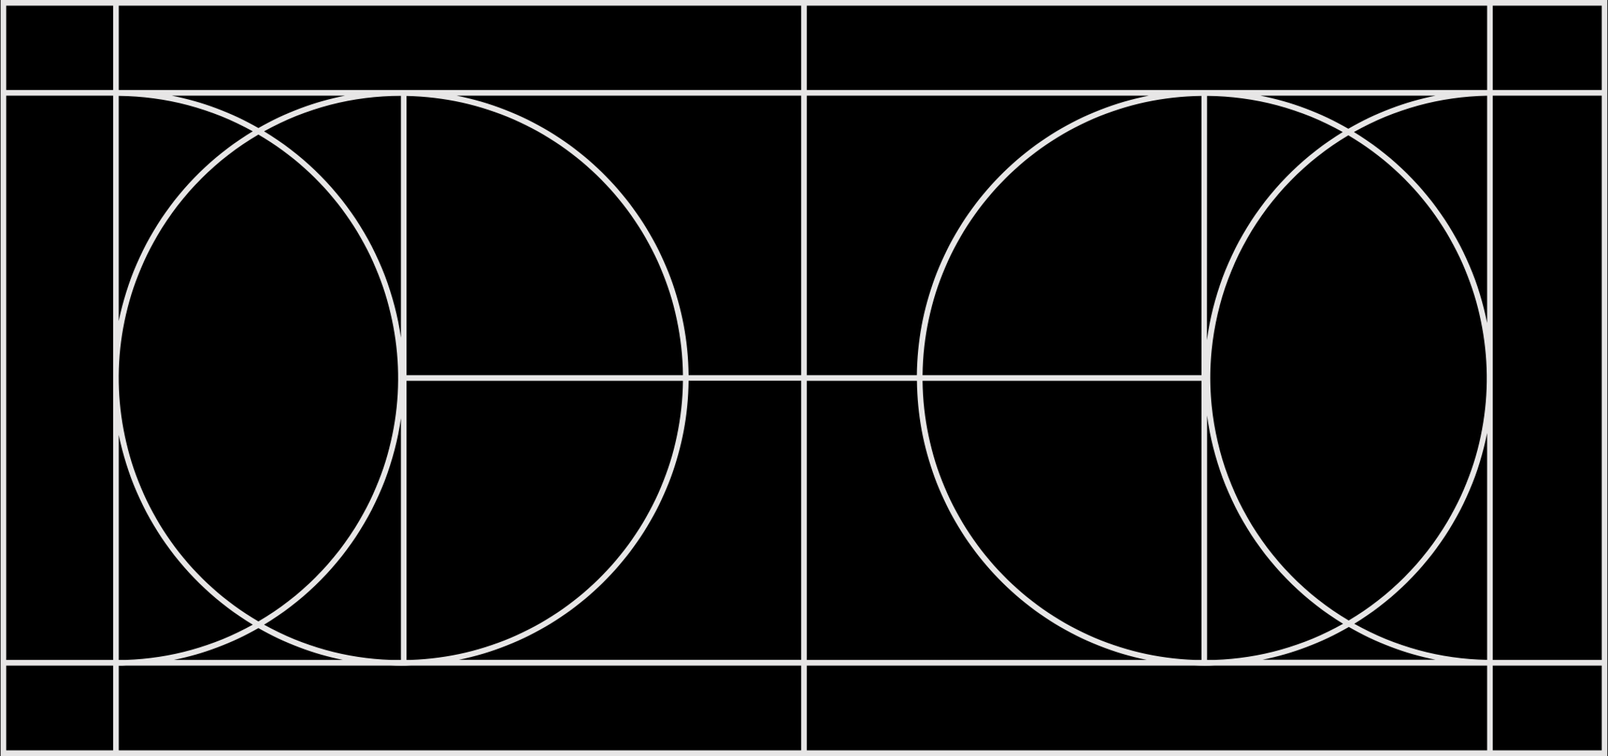
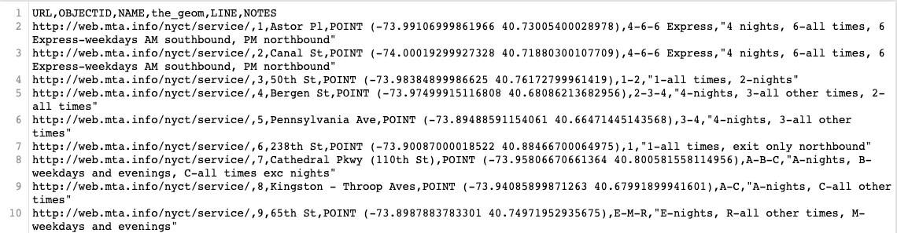
How to create neo4j graph from Csv File file structure

Slide 3
Expected out put
No duplicate node for same train
All stations node will be connected to train node based on csv

Slide 4

code
q1="""
MERGE(A:TRAIN{train_name:$train_name})
MERGE(B:STATION{station_name:$station_name})
MERGE (A)-[:GOES_TO]->(B)
"""
for tname in trains:
x=df.groupby("LINE")[["NAME","LINE"]].get_group(tname)["NAME"]
for sname in x:
p={"train_name":tname,"station_name":sname}
session.run(q1,p)

Slide 5
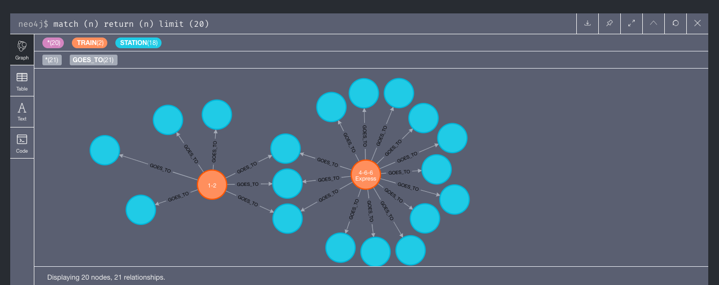
output

